Slide 1
NACDS Regional
Upcoming Changes to the NDC and how they will impact Pharmacies
Ullrich Mayeski
GS1-US Healthcare
January, 2026

Slide 2
GS1 US Anti-trust Caution
GS1 US is committed to complying fully with antitrust laws.
We ask and expect everyone to refrain from discussing prices, margins, discounts, suppliers, the timing of price changes, marketing or product plans, or other competitively sensitive topics.
If anyone has concerns about the propriety of a discussion, please inform a
GS1 US® representative as soon as possible.
Please remember to make your own business decisions and that all GS1 Standards are voluntary and not mandatory.
Please review the complete GS1 US antitrust policy at:
www.gs1us.org/gs1-us-antitrust-compliance-policy
Notes:
Read/Review

Slide 3
GS1 US Legal Disclosure
GS1 US, Inc. is providing this presentation, as is, as a service to interested parties. GS1 US MAKES NO REPRESENTATIONS IN THIS REGARD AND DISCLAIMS ALL WARRANTIES, EITHER EXPRESS OR IMPLIED, INCLUDING BUT NOT LIMITED TO, ANY WARRANTY OF ACCURACY OR RELIABILITY OF ANY CONTENT, NONINFRINGEMENT, MERCHANTABILITY, OR FITNESS FOR A PARTICULAR PURPOSE.
GS1 US shall not be liable for any consequential, special, indirect, incidental, liquidated, exemplary, or punitive damages of any kind or nature whatsoever, or any lost income or profits, under any theory of liability, arising out of the use of this presentation or any content herein, even if advised of the possibility of such loss or damage or if such loss or damage could have been reasonably foreseen.
GS1 US employees are not representatives or agents of the U.S. FDA, and the content of this presentation has not been reviewed, approved, or authorized by the U.S. FDA.
Notes:
Read/Review
GS1 Standards are VOLUNTARY, not mandatory

Slide 4
Agenda
Who is GS1 and what is our role in Healthcare?
What is the National Drug Code (NDC) and why is it changing?
What is the timeline for the change?
What is the impact of the change and what is Industry doing now?

Slide 5
NACDS Regional
Who is GS1 and what is our role in Healthcare?

Slide 6

GS1—The Global Language of Business
GS1 is a global standards organization
  Neutral and
  not-for-profit
  User-driven
  and governed
  Global
  and local
  Inclusive and
  collaborative

Slide 7
GS1 by the Numbers
1.5 million
companies around the world use
GS1 Standards.
More than 6 billion
GS1 barcodes are scanned every day.
36+ million GTINs
and 600,000+ GS1 Company Prefixes are in the GS1 US Data Hub | Product tool.
More than 37 million
products are registered by brand owners in the GS1 Global Data Synchronization Network™ (GDSN®).

Slide 8

GS1 Standards: Identify, Capture, and Share
GS1 Standards for identifying, capturing, and sharing information—about products, business locations, and more—make it possible for companies to speak the same language, connect with each other, and move their business forward.

Slide 9

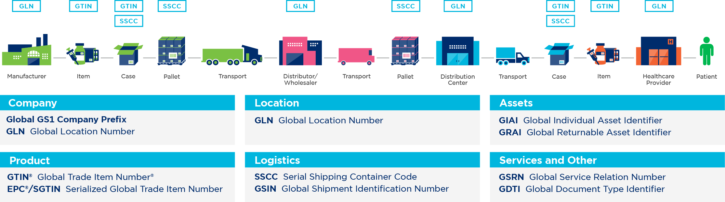

Identify: GS1 Identification Numbers
GS1 Standards begin with GS1 Identification Numbers
used to uniquely identify products (trade items), logistics units, locations, assets, and relationships across the supply chain.

Slide 10

Capture: GS1 Data Carriers
GS1 Data Carriers are capable of holding varying amounts of data to accommodate different needs for different products.

Slide 11
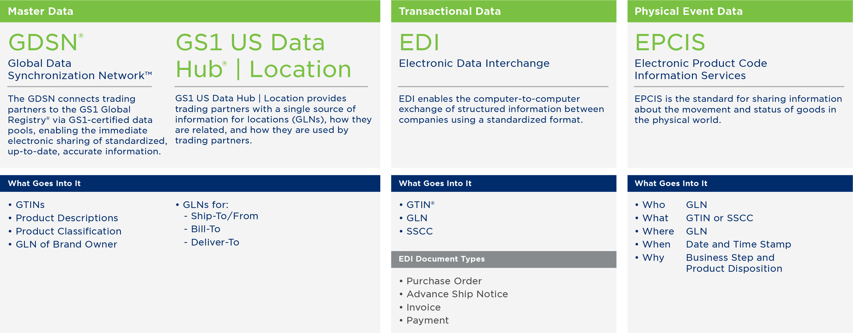
Share: GS1 Data Exchange
Interoperability, made possible by identification standards,
data capture standards, and data exchange standards, allows product information to flow through the supply chain.

Slide 12
NACDS Regional
What is the National Drug Code (NDC) and why is it changing?

Slide 13
National Drug Code (NDC)
The National Drug Code (NDC) functions as one of the most essential master data elements in the U.S. healthcare system.
  It is a foundational attribute for identification, regulatory compliance, supply chain operations, reimbursement, interoperability, and helping to ensure patient safety.
  NDC management is the responsibility of the Food & Drug Administration (FDA)

Slide 14
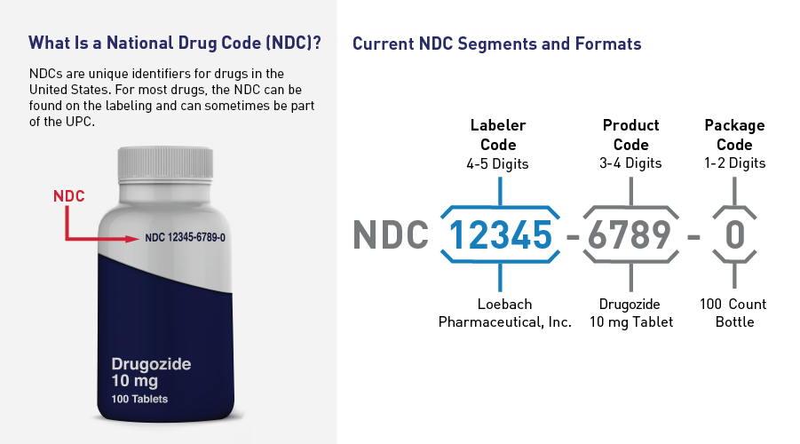
National Drug Code (NDC)
Source: FDA

Slide 15
NDC Proposed Rule Change
On 07/22/2022, the FDA released a proposed rule (Revising the National Drug Code Format and Drug Label Barcode Requirements) to adopt a single, uniform 12-digit format for National Drug Codes (NDC).
  The rule is being proposed because the amount of available NDC codes (specifically, labeler codes) is expected to be exhausted between 2030 and 2035. Due to impact of this change, it is believed that industry will require five to seven years to transition away from the current format.
  The proposed rule would eliminate the linear UPC bar code requirement, permitting manufacturers to migrate to the 2D DataMatrix/DSCSA product identifier only.

Slide 16
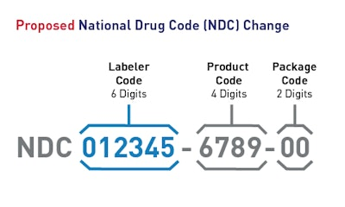
NDC Proposed Rule Change
Proposed rule would update the length of NDCs to 12 digits.
If finalized, all NDCs would be expanded from 10 digits to 12 digits after a three-year transition period.
21 C.F.R.§ 201.25(c) would be revised to allow the use of linear or nonlinear barcodes that meet specified standards.
Source: FDA
Labeler code, product code and package code digits will be all fixed length

Slide 17
NACDS Regional
What is the timeline for the change?

Slide 18
NDC Change: FDA Plan 5 Years after finalization.
FDA would convert all NDCs to 12 digits, and begin assigning 6-digit labeler codes and NDCs in the new 12-digit format
Stakeholders should have completed updates that would enable systems to be capable of handling the new uniform, 12-digt NDC
Firms should start labeling drugs that were assigned 10-digit NDCs with the new 12-digit NDC format.
Drug listing submissions would be required to use the new 12-digit NDC format

Slide 19
NDC Change: The Transition Period
FDA is proposing 3-year transition period following the effective date.
During the transition period:
  FDA would publish and maintain both 10 and 12-digit NDCs
  Drugs that were assigned a 10-digit NDC prior to effective data will be allowed to continue to be labeled with the 10-digit NDC code.
  FDA is encouraging manufacturers and distributors to include 12-digit NDCs on drug labeling as soon as possible after effective date but no later than when the firm runs out of its labeling inventory for the drug, and orders or begins printing new labeling

Slide 20
Timeline of Proposed Change
2026
2027
2028
2029
2029
2030
2031
2032
2033
Rule Finalized
12-Digit NDC Issued
10-Digit NDC Sunsets
Transition period
Timeline based on estimated rule finalization in 1H 2026

Slide 21
NACDS Regional
What is the impact of the change and what is Industry doing now?

Slide 22
System and Other Implications
Over 100 systems have been identified as impacted by the change including those used by trading partners, supporting organizations, and federal and state agency systems.
Concern that certain legacy systems may become obsolete through this process as the effort to update may not be achievable.
Sequencing and coordination of the change within these systems will be essential.
System stabilization period will need to occur due to the focus of time, resources, and cost to system changes hindering other initiatives.
Implications to system interfaces between companies and organizations.
Change impacts the company’s processes and organization’s communications.
Interfaces will need to be updated and piloted amongst trading partners.
Current analysis does not yet capture systems impacted by adjacent businesses that support the industry including 3rd Party logistic companies
Notes:
As there can be an interdependency among systems, industry will need to work together to prioritize, sequence, and plan to minimize the impact on the supply chain and mitigate patient impact.

Slide 23
Transition – Significant, Widespread, Y2K-Like
There are three categories of systems impacted by the change in the NDC format:
  The barcoding system
  The systems used by organizations within the Healthcare industry
  The interfaces between organizations
The industry will no longer be able to use the linear UPC barcode due to the increased length of the NDC to 12-digits as it exceeds the maximum character allowance.
  This will result in a greater need by industry to use the 2D DataMatrix barcode to carry the 5 product data elements within a certain space.

Slide 24
Potential impacts identified for pharmacies
Issues to consider include:
Pharmacies will have unique challenges in preparing for the change.
Operating in an environment with both 10 and 12-digit NDCs that will increase complexity.
Claims & adjudication readiness
Pharmacy management, eRx & clinical systems.
Barcode scanning impact
Inventory, Point of Sale & item master alignment
DSCSA & product identifiers
340B & government program compliance
State & Federal reporting
Recall management
Trading partner & EDI dependencies including Price Files, Purchase Orders, Invoices and Advance Shipment Notifications
Historical data continuity
People, process & timelines

Slide 25
Impact to Other Industries and Organizations
Many industries and organizations interact with products that are required to be identified by NDCs.
Retail Grocery
Apparel/General Merchandising
[i.e., Target, Walmart, etc.]
Supporting Organizations
Nonprescription products (OTC)
Nonprescription products (OTC)
Dental Products
Animal products
Logistics Providers
Prescription medication (with pharmacy)
Prescription medication (with pharmacy)
Government Agencies
Dental Products
Medical supplies (hand sanitizer, rubbing alcohol)
Medical supplies (hand sanitizer, rubbing alcohol)
Animal products
Solution Providers
Wholesalers/Distributors

Slide 26
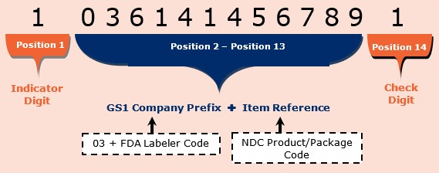
GS1 Identifiers – Current Structure
Currently, the U.S. FDA issued Labeler code is embedded into the GS1 Company Prefix.
This enables the National Drug Code (NDC) to also be embedded within the GS1 Global Trade Item Number® (GTIN®).
U.S. FDA-assigned Labeler Code | 61414
Append GS1 US Placeholder | 03
GS1 Company Prefix | 0361414
Notes:
With the expansion to 6-digits for the Labeler code and the overall expansion to a 12-digit NDC (versus the current 10-digits), there will need to be a change.

Slide 27
New AI Created for Separate NDC
GS1 created an Application Identifier (AI) for the NDC, AI (715), in 2021 to accommodate the increase in the number of digits in the proposed rule
  This approach is consistent with the approach taken for other countries that require a country specific identifier (e.g., Germany, France, Spain, Brazil, and Portugal).
GS1 AIs are a finite set of specialized identifiers encoded within barcodes to indicate the type of data represented in the various barcode segments.
Each AI is a two, three, or four-digit numeric code. Each data element in a barcode is preceded by its AI.
There are approximately 100 AIs in the GS1 System. GS1 AIs commonly used in healthcare include AI (10) for lot/batch number, AI (17) for expiration date, and AI (21) for serial number.
Notes:
The adoption and use of the new Application Identifier (715) will be needed in the industry.

Slide 28
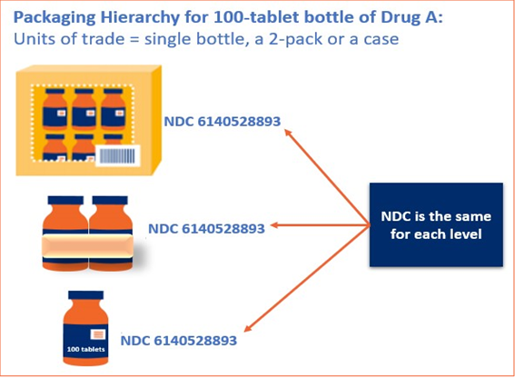
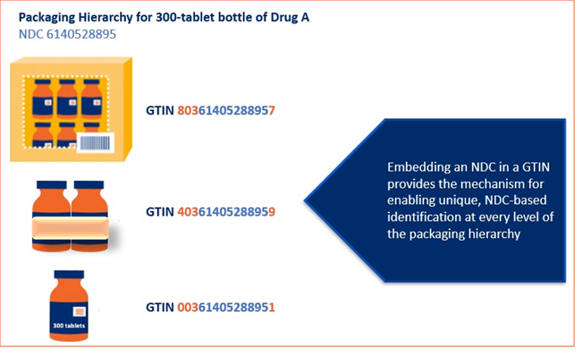
Difference Between NDC and GTIN
The new NDC format amplifies the need to associate an NDC with GTIN to uniquely identify a product at every packaging hierarchy.
Notes:
While the NDC can no longer be embedded in the product GTIN, the association of GTIN to NDC remains critical.

Slide 29
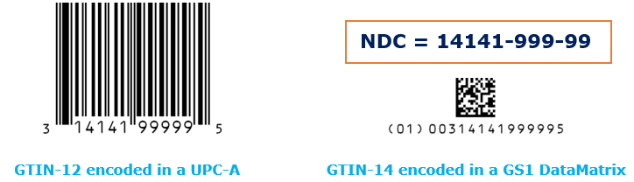
Barcoding Implications with this Change
The transition of the NDC out of the GTIN structure and into an AI impacts the barcodes available for products that need to encode their NDC.
The UPC barcodes (commonly used by the pharmaceuticals industry for the linear barcode rule) cannot carry AIs and therefore cannot be used to carry an NDC that is encoded as an AI.
There are three GS1 barcodes that could carry the NDC AI: GS1-128, GS1 DataMatrix, and
GS1 DataBar®.
Barcode selection will need to consider symbol size and capacity (i.e., the number of characters that can be encoded) for very small healthcare products and/or DSCSA-marked products that must carry several data elements.

Slide 30
With the increase in length of the Labeler Code, the NDC will no longer be embedded within the GTIN. The important relationship between the NDC and GTIN remains, but switches to association of the NDC to GTIN and removes smart numbering.

Slide 31
What is the role of GS1-US?
1 Workgroup, 1 Discussion Group, and Standards Committee in addition to education and awareness
New NDC Format Workgroup – Apply resources to support final rule and transition for industry. When the change is finalized, GS1 is positioned to utilize a standards based-approach to assist members and the industry with implementation.
New NDC Format Industry Discussion Group – Awareness and impact. Because the rule impacts systems and organizations both in and out of the healthcare supply chain, GS1 is prepared to facilitate discussions across multiple organizations in a neutral format so critical information relevant to internal and external stakeholders for the change can be received and considered.
Potential Standards Committee with other Standards Organizations like HFMA (Healthcare Financial Management Association), NCPDP (National Council for Prescription Drugs Program) and others to coordinate communication and resources.

Slide 32
Thank you for your time!
Are there any QUESTIONS?

Slide 33
GS1 US Healthcare Website
Explore the GS1 US Healthcare webpages for insightful information, guidance, use cases and training on GS1 Standards use in support of regulations and supply chain optimization
https://www.gs1us.org/industries-and-insights/by-industry/healthcare

Slide 34



GS1 US Education & Training
GS1 US University offers diverse education and training opportunities to help individuals and companies understand how to use GS1 Standards to improve their business processes.
GS1 US® certificate courses and workshops are in-depth, interactive in-person and virtual classroom events.
Live and on-demand webinars feature the opportunity to get your questions answered by the experts.
Online training courses provide on-demand access to a library of educational modules, videos, and full-length certificate course materials.
Learn more: www.gs1us.org/university
Notes:
Healthcare specific courses in a variety of formats on GS1 Standards Basics, UDI, DSCSA for impacted stakeholder roles
GS1 US also offers one on one advisory services to assist with implementation of GS1 Standards to support UDI or DSCSA.

Slide 35
Contact Information
Name
Ullrich Mayeski, J.D.
Director, Customer Success- Healthcare
GS1 US Corporate Headquarters
Princeton South Corporate Center
300 Charles Ewing Boulevard
Ewing, NJ 08628 USA
615.540.4277
umayeski@gs1us.org

Slide 36
Trademark Notices
DataBar®, EAN®, EPC®, EPCglobal®, GDSN®, GS1 Global Registry®, GTIN®,
and Global Trade Item Number® are registered trademarks of GS1 AISBL.
GS1 US® and design is a registered trademark of GS1 US, Inc. Trademarks appearing in this presentation are owned by GS1 US, Inc. unless otherwise noted,
and may not be used without the permission of GS1 US, Inc.
The letters “U.P.C.” are used solely as an abbreviation for the “Universal Product Code” which is a product identification system. They do not refer to the UPC,
which is a federally registered certification mark of the International Association
of Plumbing and Mechanical Officials (IAPMO) to certify compliance with a Uniform Plumbing Code as authorized by IAPMO.

