Slide 1


DEA Regulatory UPDATE 2026
Karla L. Palmer, Esq.
Hyman, Phelps & McNamara, P.C.
Ronald J. Friedman, Esq.
Ogden Murphy Wallace P.L.L.C.
2026 NACDS Regional Conference
Bonita Springs, FLA

Slide 2
Conflict of Interest Disclosure
We declare that neither we nor any immediate family member have a current affiliation or financial arrangement with any potential sponsor and/or organization(s) that may have a direct interest in the subject matter of this presentation.

Slide 3
Learning Objectives
At the completion of this activity, the participant will be able to:
  Understand DEA’s Regulatory Agenda for the Drug Enforcement Administration, including the status of proposed and final rules during 2025.
  Describe proposed DEA regulations related to telemedicine, proposed special registration and marijuana.
  Know select Trump Administration Executive Orders and how those Orders affect pending regulations.
  Understand DEA's rulemaking process relating to pending marijuana scheduling, telemedicine regulations, and special registration in telemedicine.

Slide 4
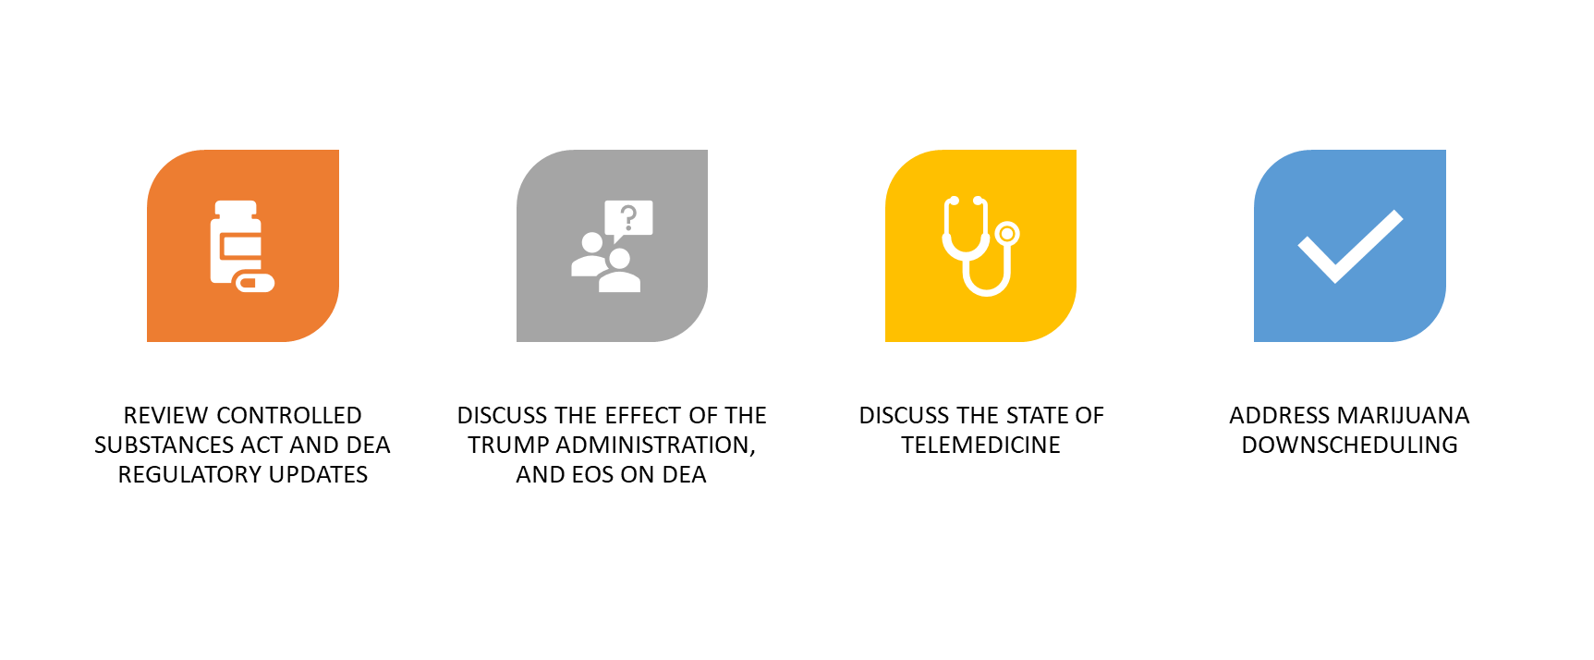
AGENDA TOPICS

Slide 5


What was DEA planning for 2025?

Slide 6

DEA Regulatory Agenda

Slide 7
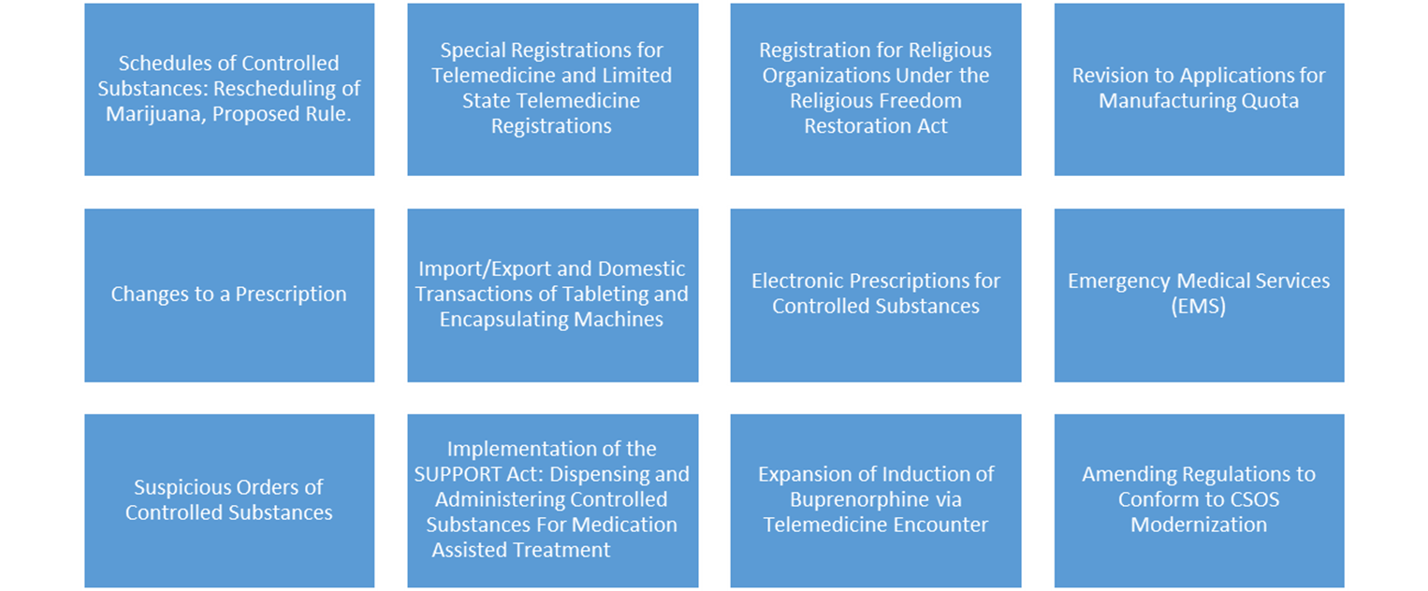
DEA Regulatory Agenda – Fall 2024

Slide 8
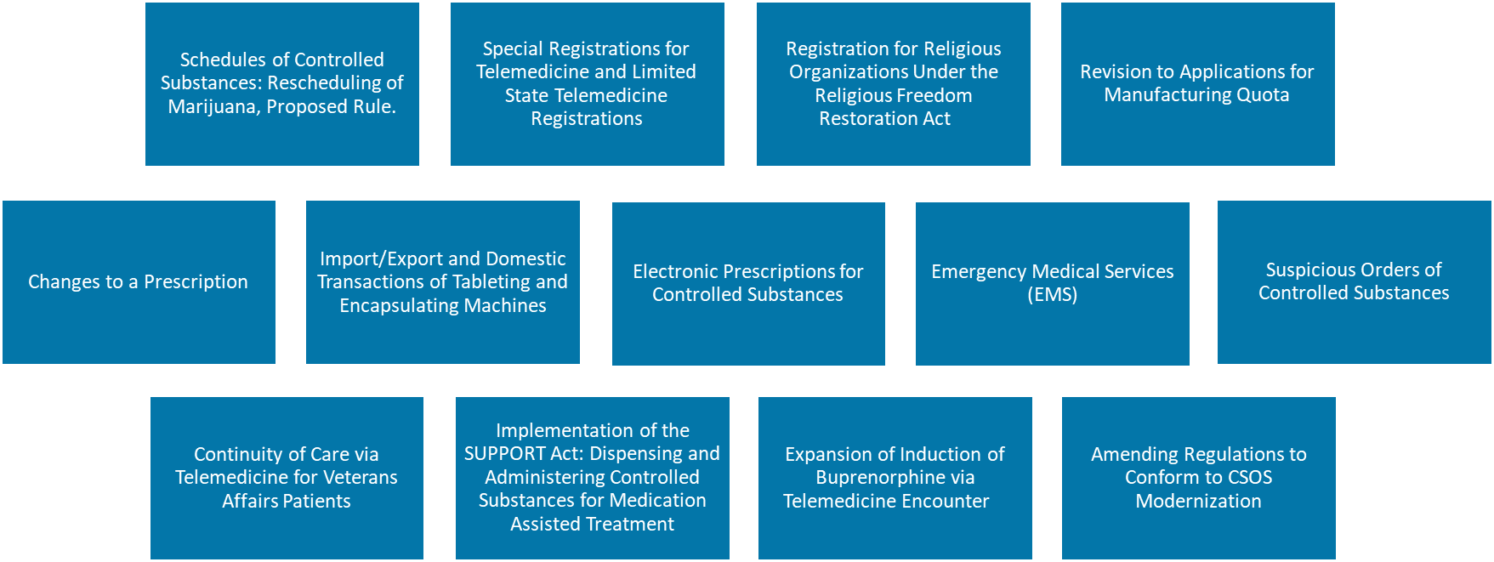

DEA Regulatory Agenda – Spring 2025

Slide 9
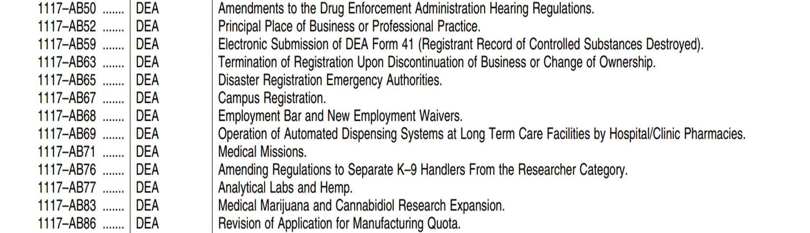

DEA Regulatory Agenda – Fall 2025

Slide 10

Executive Order/Statements Potentially Affecting DEA
Regulatory Freeze Pending Review – January 20, 2025
This Order requires all executive departments and agencies to take the following steps:
  Agencies cannot propose or issue any rules without them first being reviewed and approved by a department or agency head appointed or designated by President Trump. (Guidance documents affected as well).
  Agencies must withdraw any rules that have been sent to the Federal Register, but have not yet been published, for review and approval by the new agency head.
  Agencies must consider postponing for 60 days any rules that have been published or otherwise issued but have not yet taken effect, to be reviewed for questions of fact, law, and policy. If there are substantial questions of fact, law, or policy, agencies should take further action in consultation with the OMB.
    Effect on DEA?

Slide 11
Executive Orders/Statements Potentially Affecting DEA
Unleashing Prosperity Through Deregulation (EO 14192) – January 31, 2025
This EO is referred to as the “one-in, 10-out order” because for every one new regulation, ten must be identified to eliminate.
Definition of “regulation” is also expansive. It includes memoranda, guidance documents, policy statements, and interagency agreements not otherwise covered under the Administrative Procedure Act.
  Unless prohibited by law, whenever an executive department or agency publicly proposes for notice and comment or otherwise promulgates a new regulation, it shall identify at least 10 existing regulations to be repealed.
  This practice is to ensure that the cost of planned regulations is responsibly managed and controlled through a rigorous regulatory budgeting process.

Slide 12

Where are we with telemedicine (T/M)???

Slide 13
A Bit of History
2008: Congress passed Ryan Haight Act (18 year-old died of overdose of Vicodin purchased through online pharmacy based only on completing online form)
Result:
21 U.S.C. § 829(e): Enshrined concept of “at least one” in-person medical evaluation prior to prescribing controlled substances (i.e., first script), then “golden,” no longer T/M.
Still “Corresponding Responsibility” required, but no longer T/M
Remains valid law: Corresponding Responsibility + State Law
--

Slide 14
A Bit of History
Ryan Haight also created 7 categories of permissible Telemedicine (21 U.S.C. § 802(54))
Very “Wonky,” but includes: public health emergency, and authority of DEA to create a “special registration” for T/M

Slide 15
Guess WHAT HAPPENED?
2020 – COVID-19 hit, public health emergency declared
Never left, continues to be relied upon, T/M flex continues
Subtext? People like T/M, transformation of medicine, technology advanced
Query whether continued reliance on Ryan Haight Act and the “1 in-person visit and golden forever” really makes sense anymore?

Slide 16
Since covid
2023-2025: DEA published various draft rules, some of which were recalled/postponed due to negative comments.
Converging on 3 Rules – 1 for VA, 1 for SUD Treatment, and one for general Special Registration.
January 2025: VA and SUD were in “final” form, the Special Registration was in proposed/draft form.

Slide 17
fourth Temporary Ryan Haight Extension
Finally, on December 31, 2025, DEA spoke.
Affected the VA and SUD Treatment Rule
And extended Telemedicine flexibilities at least another year, until December 31, 2026, to work on the Special Registration
Giving practitioners a choice between these rules????

Slide 18
Score? D
DEA waited until the very last moment.
Only got done the easiest part, kicked the ball down road on the hard part.
And even then, created confusion.

Slide 19
2 Final Rules
VA – Must see a provider once, then “golden” (= group practice rule)
SUD – Allows 6 months of prescriptions for T/M before in-person visit required.
  Restricted to CIII-V FDA-approved medications for OUD

Slide 20
SUD Rule IMPACT on PHARMACY
Requirement to check and create a record of identification of patient or person picking up the prescription.
But how would the pharmacy ever know if practitioner is using the new rule? They wouldn’t!

Slide 21
status of Special Registration(s)?
Telemedicine Prescribing Registration
Authorizing qualified clinician practitioners to prescribe Schedule III-V controlled substances via telemedicine
Advanced Telemedicine Prescribing Registration
Authorizing qualified, specialized clinician practitioners (e.g., psychiatrists, hospice care physicians) to prescribe Schedule II-V controlled substances via telemedicine
Telemedicine Platform Registration
Authorizing covered online telemedicine platforms, in their capacity as platform practitioners, to dispense Schedule II-V controlled substances

Slide 22
Prescriber’s DEA # on script
Regular DEA reg # of practitioner in State of patient
Special T/M DEA reg # of practitioner (national)
State DEA Telemedicine Registration number
Special T/M reg # of platform (national)
Platform’s State DEA reg #
= 5 DEA Numbers, does not even include any State numbers, if required.
Pharmacy to monitor???

Slide 23
ADDED BURDENS on Pharmacy if enacted
Adds provision saying if prescription does not contain all required #’s then that is a failure by pharmacist of “corresponding responsibility” obligation
Adds cumbersome additional pharmacy reporting requirements:
“Within 7 days of start of every month, pharmacy report aggregate data, for prior month of all prescriptions filled pursuant to a Special Registration, per state.”

Slide 24
let us hope…
This is DEA’s second attempted draft rule. Initial draft of the Special Registration rule was withdrawn due to the number of public of comments received, (“received 38,000 public comments, which was a record number.”)
But… current draft rules: nearly 42,000 comments, so you tell me!

Slide 25

Marijuana Rescheduling Proceedings

Slide 26

Current State of Marijuana Rescheduling Proposed Rule
Proposed Rescheduling Rule, published in May 2024, received 43,000 comments.
69% of comments support complete descheduling
DEA scheduled hearing before then-Chief ALJ Mulrooney, (to occur December 2024).
DEA determined parties to participate at hearing.
Rescheduled hearing was to begin on January 21, 2025
Filed motion concerning ex parte communications that occurred between DEA and third parties
ALJ Mulrooney stayed the matter, pending interlocutory appeal of his decision concerning the ex parte communications.
New President, new DEA Administrator…
Judge Mulrooney retired July 31, 2025…

Slide 27

Decision of ALJ Mulrooney: Stay Pending Interlocutory Appeal
Judge Mulrooney’s Decision staying the proceedings is linked here.
A few quotes from the Decision (emphasis added):
  “To be sure, the specter of officials at the highest level of Agency management selectively assisting and granting access to individuals and groups standing in opposition to the NPRM it purportedly supports as the proponent, carries no small measure of discomfiture. If true, viewed in the best light, these allegations demonstrate a puzzling and grotesque lack of understanding and poor judgment from high-level officials at a major federal agency with a wealth of prior experience with the APA. And that is a charitable perspective.”
“Even factoring in the reality that sometimes litigants and their representatives should be mindful of what they wish for, to the extent my analysis is found to be in error on review, I am willing to certify that the allowance of this interlocutory appeal could potentially avoid exceptional delay, expense or prejudice to the DPs and the Government by injecting appellate certainty into the equation at this stage of proceedings. Were my analysis to be reviewed on appeal and determined to constitute prejudicial error, a remand would clearly result in significant delay and expense to the Designated Participants and the process.”

Slide 28


Slide 29
Marijuana executive order:
  In 2023, FDA completed a review of medical use of marijuana and found scientific support for its use to treat anorexia related to a medical condition, nausea and vomiting, and pain.
  40 States plus DC have State- or locally-sanctioned, regulated medical marijuana programs.
  Decades of Federal drug control policy have neglected marijuana’s medical uses. That oversight has limited the ability of scientists and manufacturers to complete the necessary research on safety and efficacy to inform doctors and patients.
  In 2023, the HHS recommended to the DEA that marijuana be controlled under Schedule III of the CSA.
Sec. 2. Rescheduling Medical Marijuana and Improving Access to Cannabidiol Products. (a) The Attorney General shall take all necessary steps to complete the rulemaking process related to rescheduling marijuana to Schedule III of the CSA in the most expeditious manner in accordance with Federal law, including 21 U.S.C. 811.

Slide 30
What would rescheduling mean?
Rescheduling to schedule III would subject marijuana cultivators, producers, processors, distributors, importers, exporters, dispensers, and practitioners to specific regulatory requirements under the CSA and DEA regulations.
Requirements would vary depending on the registered business activity.
Unless exemptions are established -- would require marijuana “businesses” to:
  Obtain DEA registrations
  Meet DEA security requirements
  Limit employees who handle product
  Invoicing/recordkeeping requirements
  Take initial and biennial inventories of marijuana on-hand
  Maintain transaction records
  File theft and significant loss reports
  Label and secure products

Slide 31
What else would rescheduling mean?
“Dispensing” marijuana to patients, as required for other schedule III substances, would require:
  A prescription issued for legitimate medical purpose by a DEA-registered and state-licensed practitioner. 21 U.S.C. § 829(b).
  Pharmacists must exercise their corresponding responsibility to ensure that marijuana they dispense is prescribed for legitimate medical purpose. 21 C.F.R. § 1306.04(a).
    Is “recreational use” a legitimate medical purpose?
Marijuana activities would be subject to CSA criminal prohibitions under 21 U.S.C. §§ 841-844.
Marijuana would also remain subject to applicable provisions of the Federal Food, Drug, and Cosmetic Act.

Slide 32
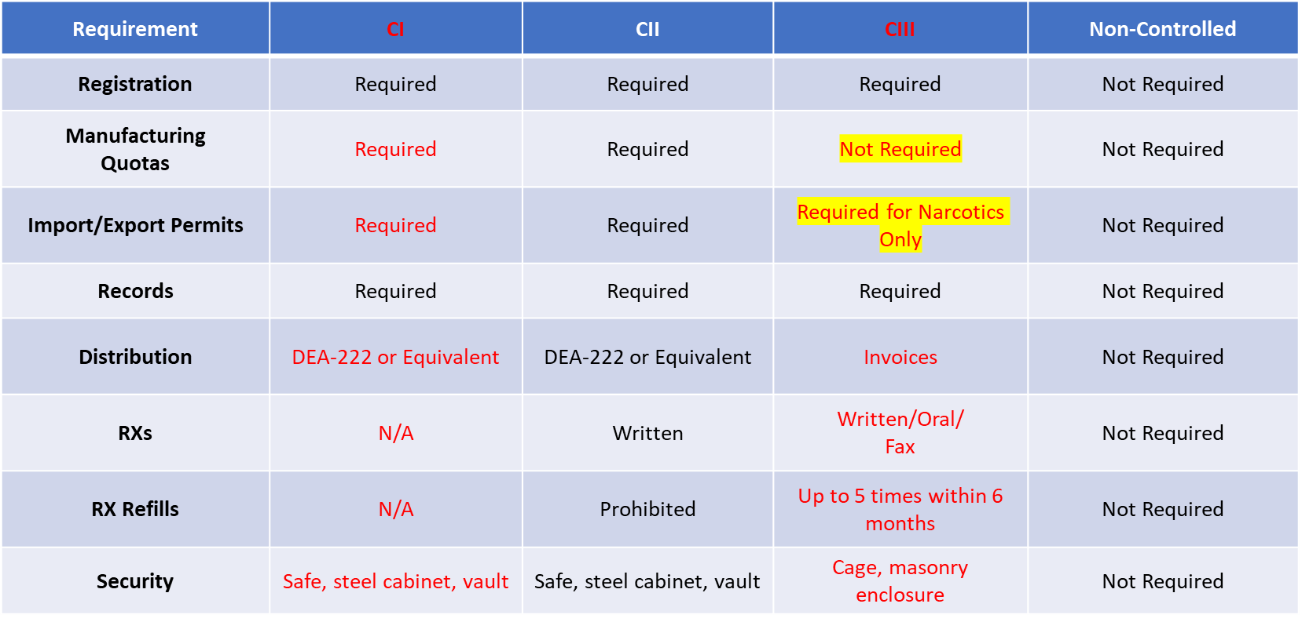
Csa requirements for scheduled drugs

Slide 33
Take Aways
Regulation of marijuana has been hotly contested federally and in states for the past 20 years.
Rescheduling of marijuana will have significant implications for the pharmacy industry.
Questions about pharmacy practice related to marijuana will take time to decipher and answer.
Industry, states, and the federal government will need to engage in collaboration and cooperation to resolve issues related to marijuana rescheduling.

Slide 34

DEA Enforcement Actions
1. ALJ Issues
2. Continued Focus on red Flags

Slide 35

ALJ Issues
As of July 2025, Judge Mulrooney was the only ALJ presiding over DEA matters
No ALJs were serving at DEA as of August 1, 2025
Cases were stayed until selection of new ALJs
  The OALJ is responsible for not only presiding over orders to show cause against DEA registrants, but also actions related to DEA decisions on imports, exports, drug scheduling, and issuing quotas.
Temporary ALJs are presiding over matters since October 2025

Slide 36
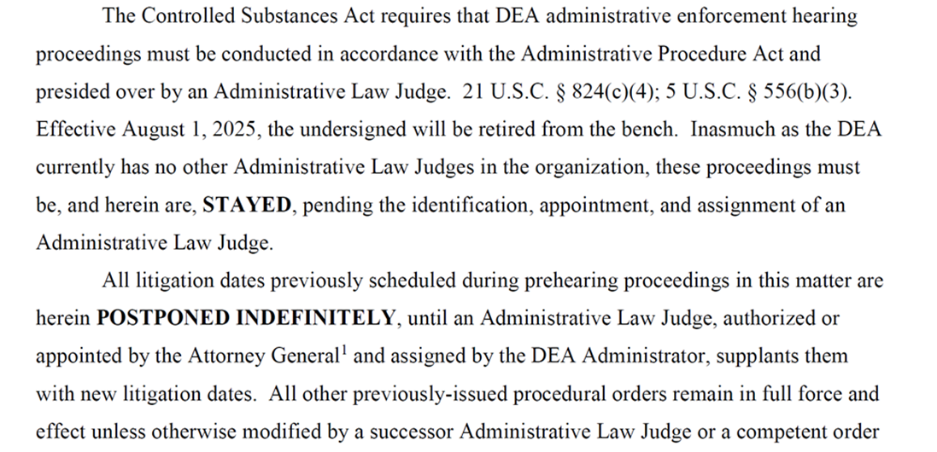

DEA’s ALJ Judge Mulrooney: August 1, 2025
UPDATE?

Slide 37
Continued “red Flag” emphasis
How does it work?
Prior to dispensing, as part of “corresponding responsibility” pharmacist must:
Examine a controlled substance prescription to see if any “red flags” are present; and
Unless those “red flags” are resolved such that the pharmacist can reasonably conclude the script is for a legitimate medical purpose by a practitioner acting in the usual course of professional practice, the pharmacist may not dispense and to knowingly do so, exposes the pharmacist to civil fines as well as potential criminal penalties.

Slide 38
Recognizing red Flags
What are the red flags?
Some are Patient focused:
  Cash pay patient with insurance, cash pay without insurance
  Suspicious patient behavior (ex. meeting other patients outside pharmacy; patients picking up scripts together, living at same address, filling similar prescriptions; patient conduct inconsistent with diagnosis); patients driving long distance to pharmacy
  Indications of patient doctor shopping on PDMP

Slide 39
Recognizing red Flags
Prescriber focused:
  Repetitive prescription pattern of prescriber.
  Sheer quantity or combination of drugs being dispensed to patient (opioids and benzos together or “DEA’s Holy Trinity”)
  Prior discipline of prescriber
  Out-of-state or unknown prescriber
  Anecdotal reports by patients or others about provider

Slide 40

Non-exhaustive list of “red flags” of diversion?
  Multiple customers filling prescriptions written by the same prescriber for the same drugs in the same quantities
  Customers with the same last name and street address presenting similar prescriptions on the same day or within a short time span
  Patients traveling long distances to fill opioid prescriptions
  Drug cocktails
  Payment by cash
  Unusually large quantity of a controlled substance
  Pattern prescribing
  Irregular dosing instructions
  Lack of individualized therapy or dosing
  Early fills/refills
  Other pharmacies’ refusals to fill the prescriptions
  Customer behavior
  Recreational use?

Slide 41
Key “Red Flag” Takeaway from reported decisions
Document your Prescription “Red Flag” Resolutions Whenever Possible.

Slide 42
Questions?

Slide 43
THANK YOU!
Karla L. Palmer, Esq.
Hyman, Phelps & McNamara, P.C.
kpalmer@hpm.com
Ronald J. Friedman, Esq.
Ogden Murphy Wallace P.L.L.C.
rfriedman@omwlaw.com

